Slide 1


College Transport Management System
UNITED COLLEGE OF ENGINEERING AND RESEARCH, ALLAHABAD (2019-23)
Presented by: (CS- Group 14)
Aashi Srivastava [1900100100001]
Kriti Srivastava [1900100100079]
Manas Dubey [1900100100081]
Sarthak Sharma [1900100100128]
Mentor: Mr. Dharmendra Kumar

Slide 2
Agenda
Introduction
Objective
Key Features
System Overview
System Architecture
System Security And Privacy
Benefits and Outcomes
Future Scope
Use Case
Conclusion

Slide 3
Introduction
Purpose: Streamline and enhance transportation services within the college
Importance: Benefits of an efficient transport management system for colleges
(i) Improved student convenience and safety
(ii) Optimized bus routes for better efficiency
(iii)Effective communication through the notice board feature
Engaging question/statistic: "Did you know that implementing a robust transport management system can reduce transportation costs by up to 20%?"
Transition: "In the following slides, we will explore the key features and benefits of the College Transport Management System."

Slide 4
Objective
1
Streamline transportation operations for efficient bus routes and reduced delays.
2
Enhance student safety through live bus tracking.
3
Improve communication & information sharing among administrators, drivers, and students.
4
Simplify bus pass issuance process for convenient application and issuance.
5
Enhance user experience with a user-friendly interface and intuitive features.
6
Ensure system security and privacy with SSL encryption and access controls.

Slide 5

Technologies Used
This slide highlights the technologies employed in the college transport management system:
Frontend:
HTML: Provides the structure and layout of web pages.
CSS: Styles and designs the user interface for a visually appealing experience.
JavaScript: Implements interactivity and dynamic functionality on the client-side.
Backend:
ASP.NET MVC framework: Serves as the web application framework for structured development.
Database:
MS SQL: Manages data storage and retrieval efficiently.
GPS: Enables live bus tracking for real-time monitoring and accurate information.
These technologies work together to create a robust and user-friendly college transport management system.

Slide 6

Why ASP.NET
Robust and scalable framework
Rapid development with the model-view-controller architecture
Extensive libraries and tools for efficient development
Language flexibility with support for multiple programming languages
Seamless integration with the Microsoft ecosystem
Built-in security features for protecting sensitive data
Support for database management with MS SQL Server
Simplified deployment and maintenance with Visual Studio
Suitable for handling high traffic and large datasets
Promotes code reusability and productivity

Slide 7
Why MySQL
Open Source: MySQL is freely available and customizable without licensing costs.
Wide Adoption and Community Support: It has a large and active user community, ensuring continuous development and support.
Performance and Scalability: MySQL offers excellent performance and scalability for handling large datasets and high traffic loads.
Compatibility and Integration: It is compatible with various operating systems, languages, and frameworks, allowing easy integration.
Reliability and Security: MySQL is known for its reliability, stability, and security features to protect data and ensure compliance.

Slide 8
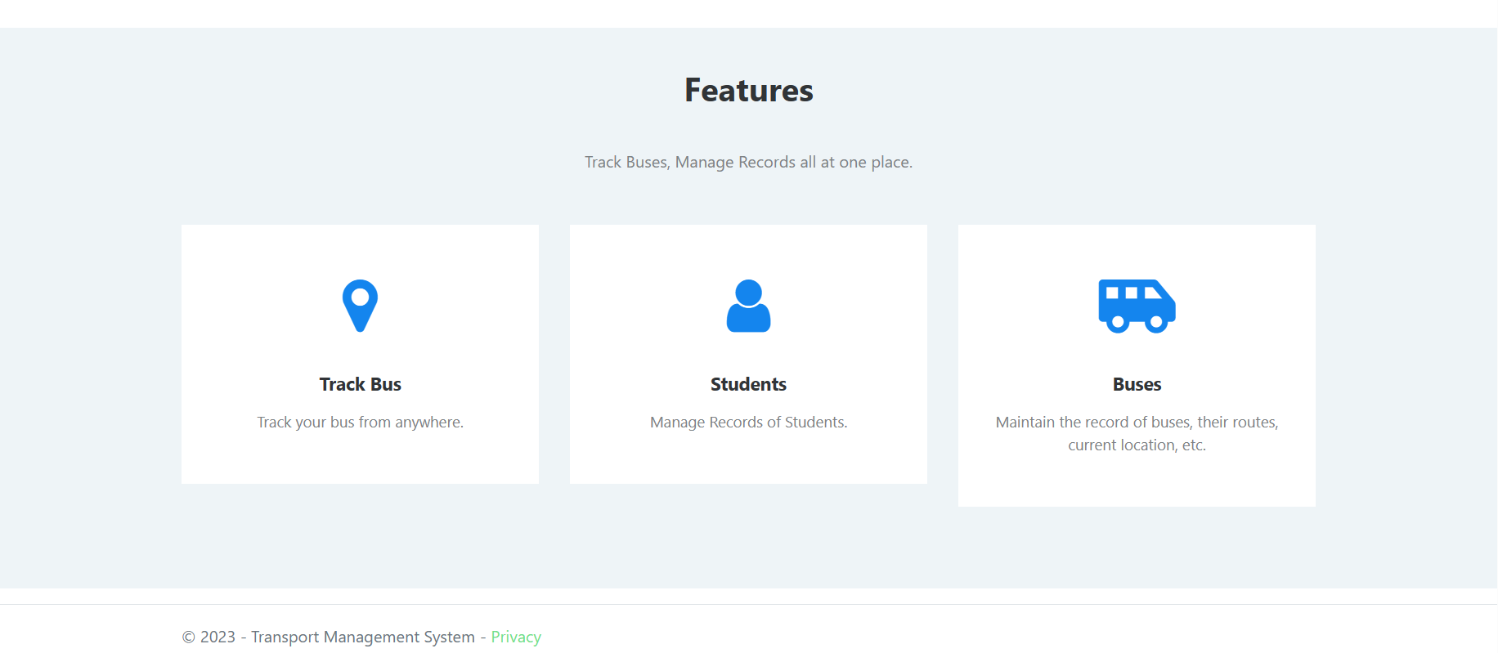
Key Features
Track bus from anywhere
Manage records of students
Maintain the record of buses, their routes, current location, etc.

Slide 9
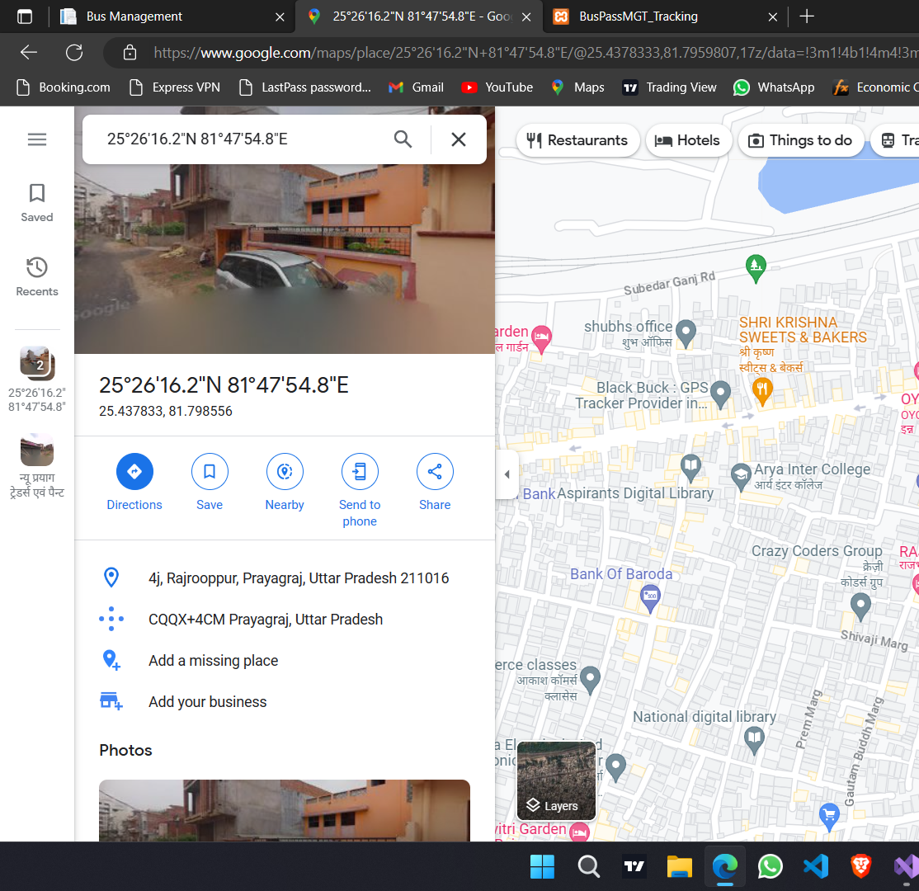
System Overview
Bus Tracking:
Real-time tracking of college buses
GPS-based location updates
Enables students to know the exact bus arrival time
Enhances student safety and security during travel

Slide 10
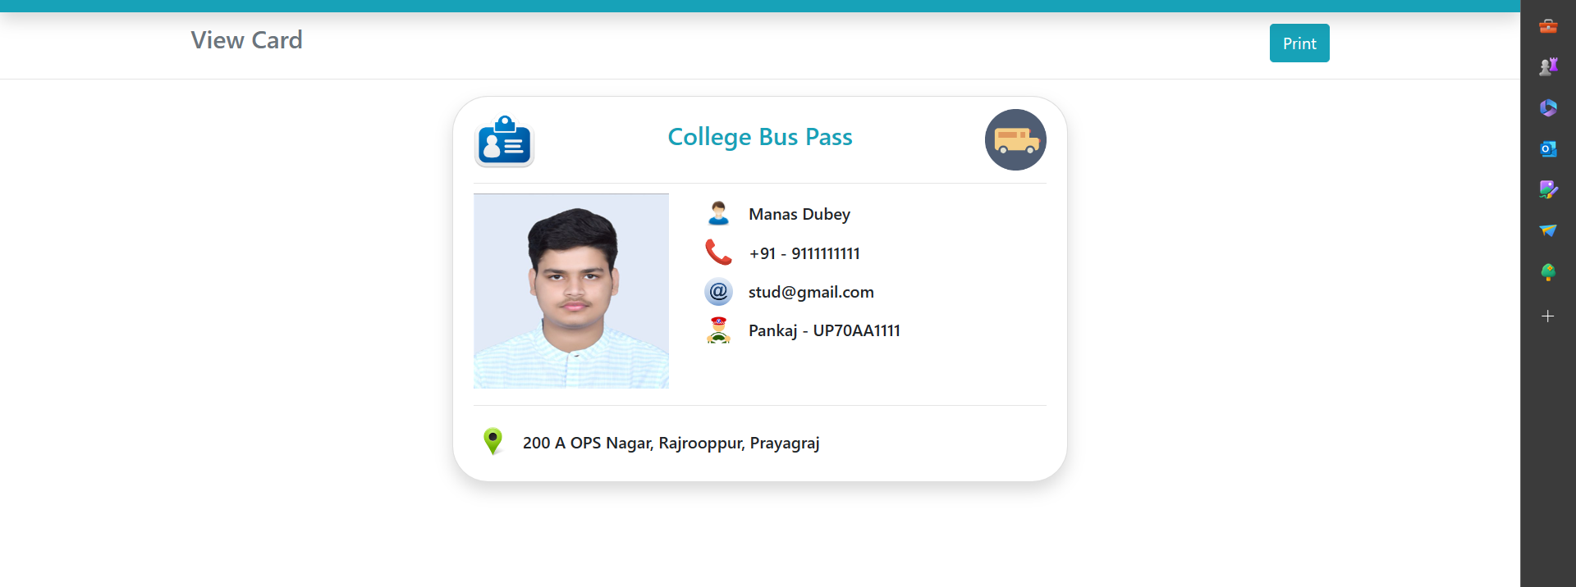
System Overview
Bus Pass Issuance:
Streamlined process for issuing bus passes to students
Online application system for requesting bus passes
Automated verification and approval process
Digital bus pass issuance for convenient access

Slide 11
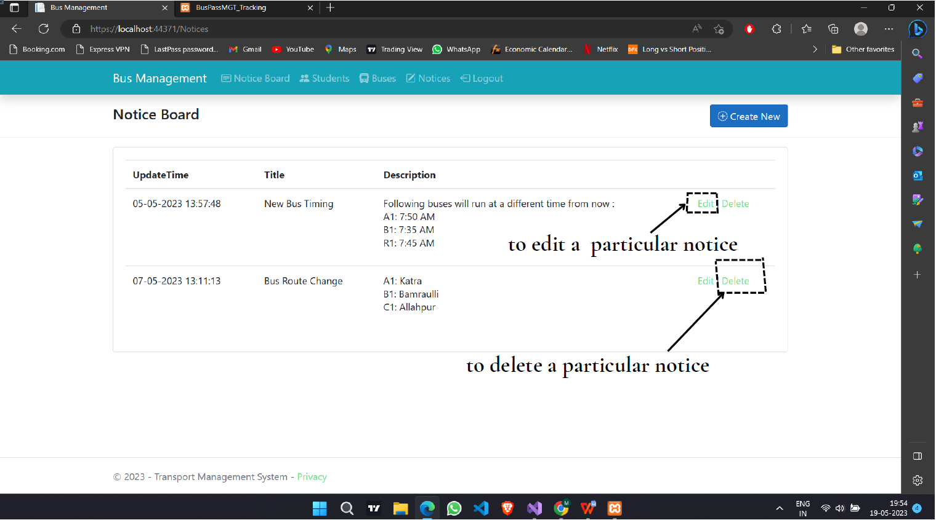
System overview
Notice Board:
Centralized platform for sharing important updates and announcements
Instant access to information for students, drivers, and administrators
Ability to create and delete notices
Post notifications, schedule changes, and other relevant updates
Promotes effective communication within the college community

Slide 12
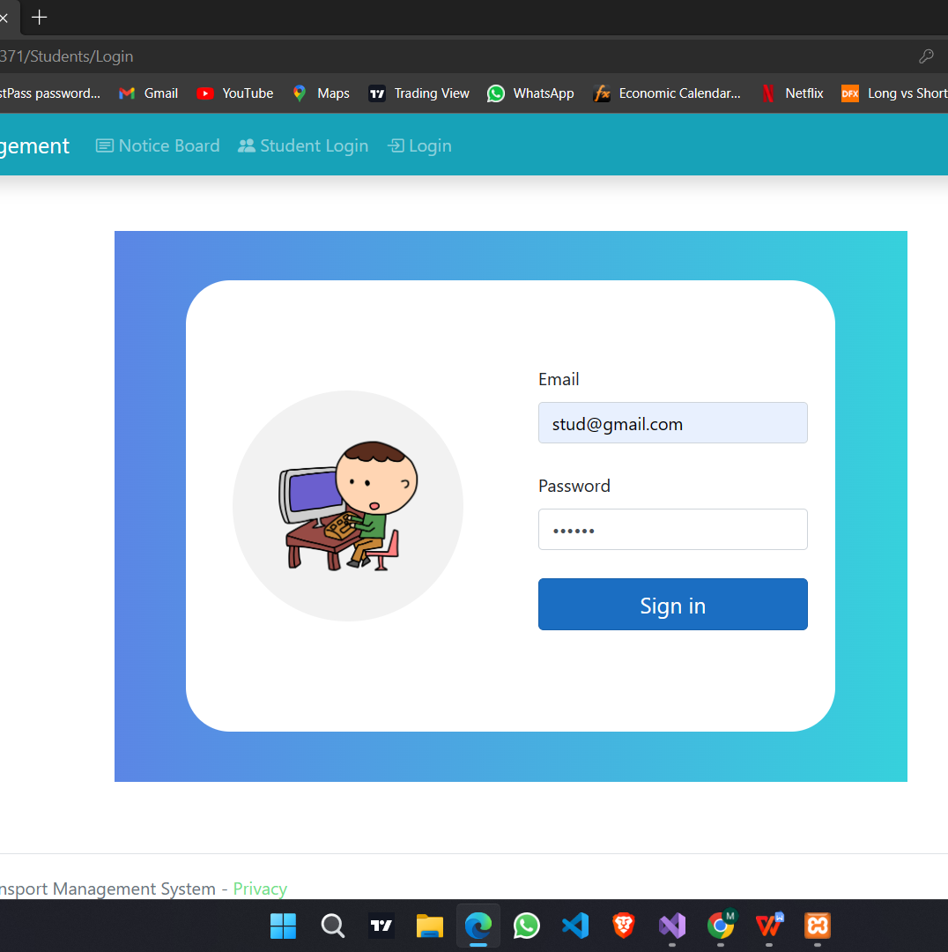
System Overview
Student login:
Access to bus route information, timings, and updates
Ability to apply for bus passes and track their status
Viewing important notices and announcements

Slide 13
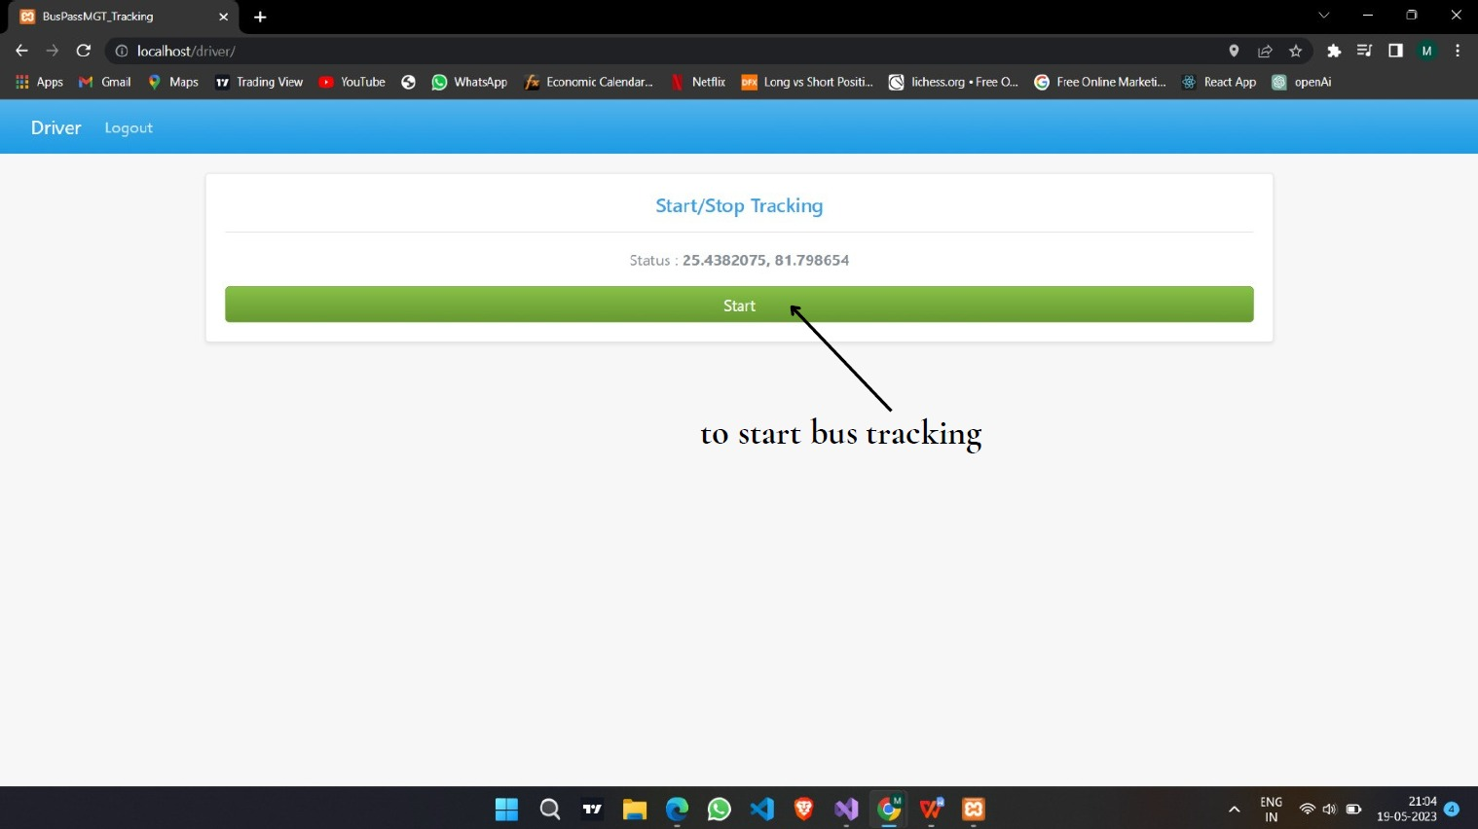
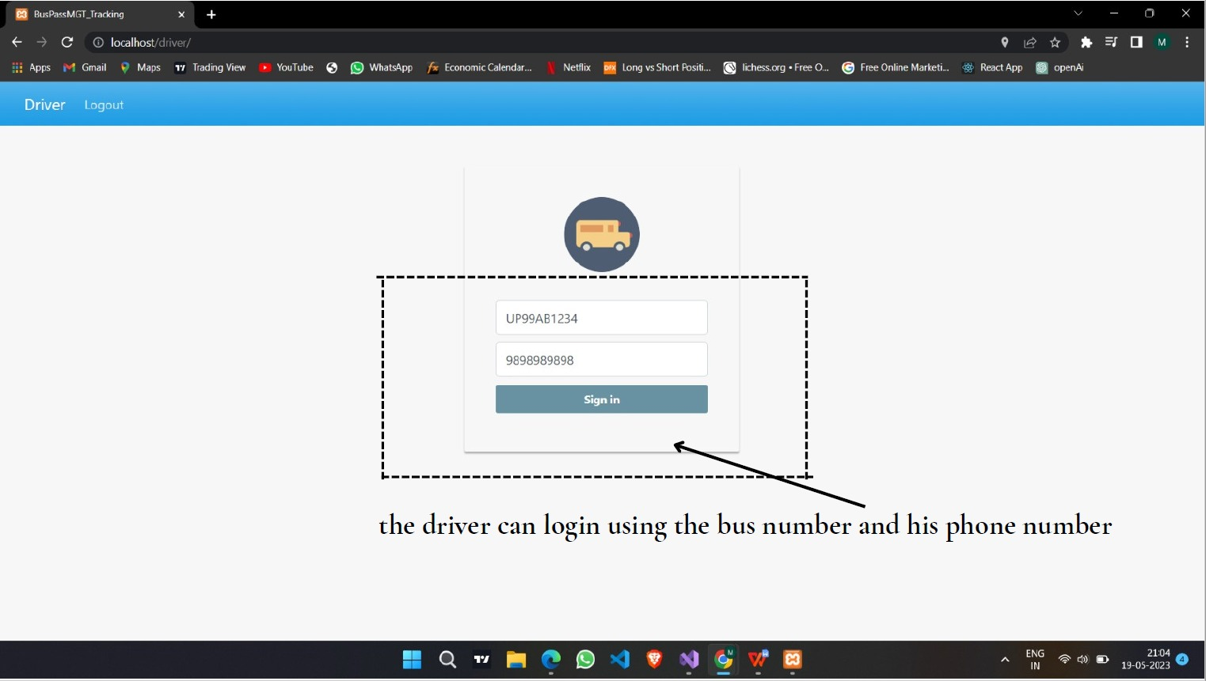
System Overview
Driver login:
Access to assigned routes, passenger details, and schedules
Ability to update bus status, report issues, and communicate with administrators

Slide 14
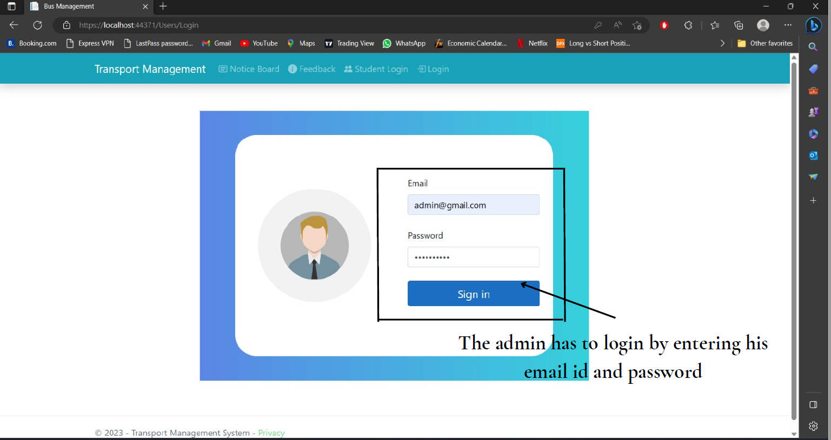
System Overview
Administrator Login:
Special access for administrators to manage the system
Dashboard for system management and oversight
Manage bus routes, schedules, and driver assignments
Issue and manage bus passes
Post notices and announcements on the notice board
Create and delete notices as necessary

Slide 15
Feedback Feature
Student Feedback: Students can provide feedback on their transportation experience, including bus conditions, driver behavior, and overall satisfaction.
Improvement Insights: Feedback data provides valuable insights to administrators, helping them identify areas for improvement and address concerns promptly.
Continuous Quality Enhancement: Regular feedback enables administrators to make data-driven decisions, implement necessary changes, and ensure the continuous improvement of transportation services.
User-Friendly Interface: The feedback feature provides an intuitive and user-friendly interface, making it easy for students to submit their feedback and suggestions.
Communication Channel: The feedback system serves as a communication channel between students and administrators, fostering transparency and engagement.

Slide 16

System Architecture

Slide 17
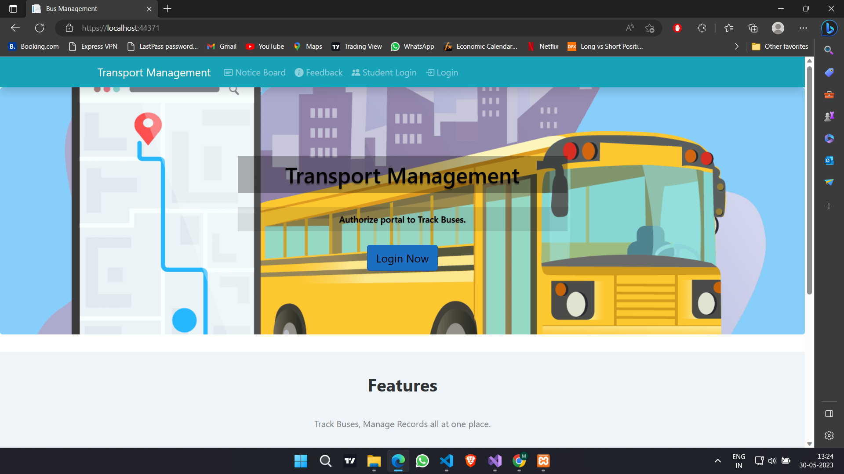
Homepage

Slide 18
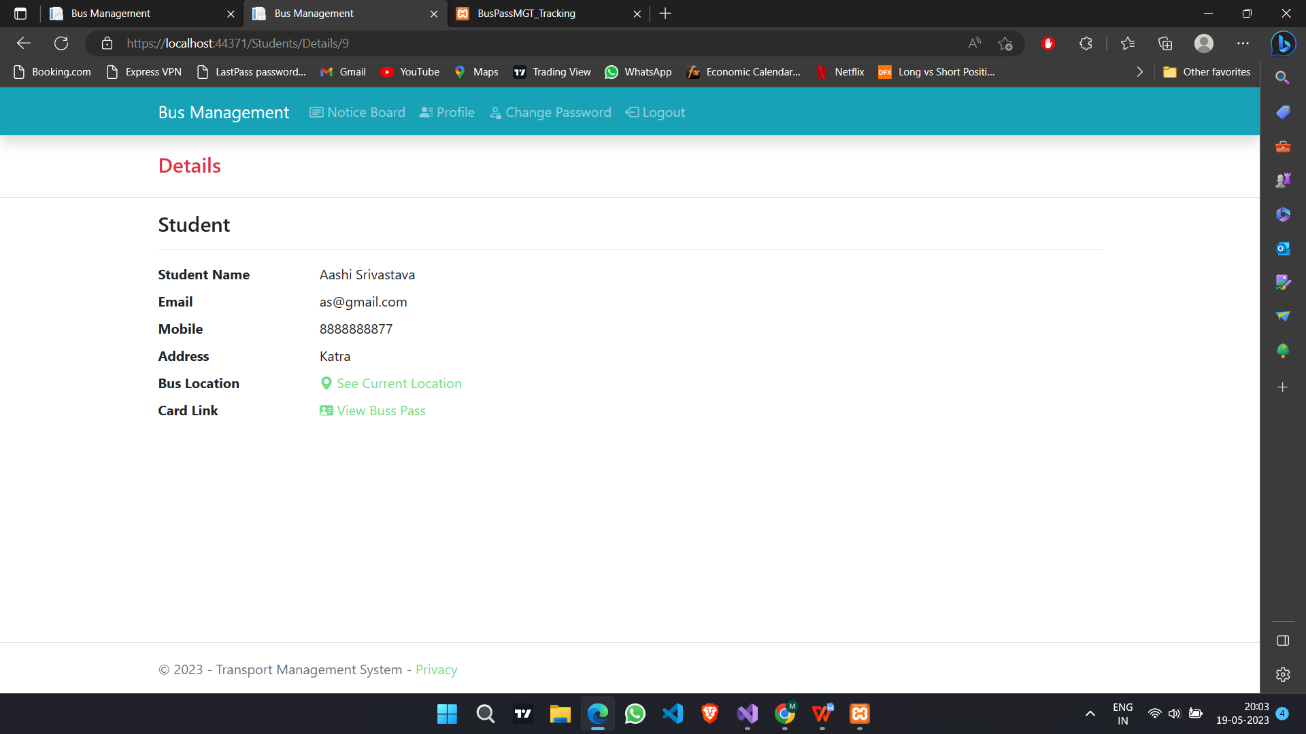
Student details

Slide 19
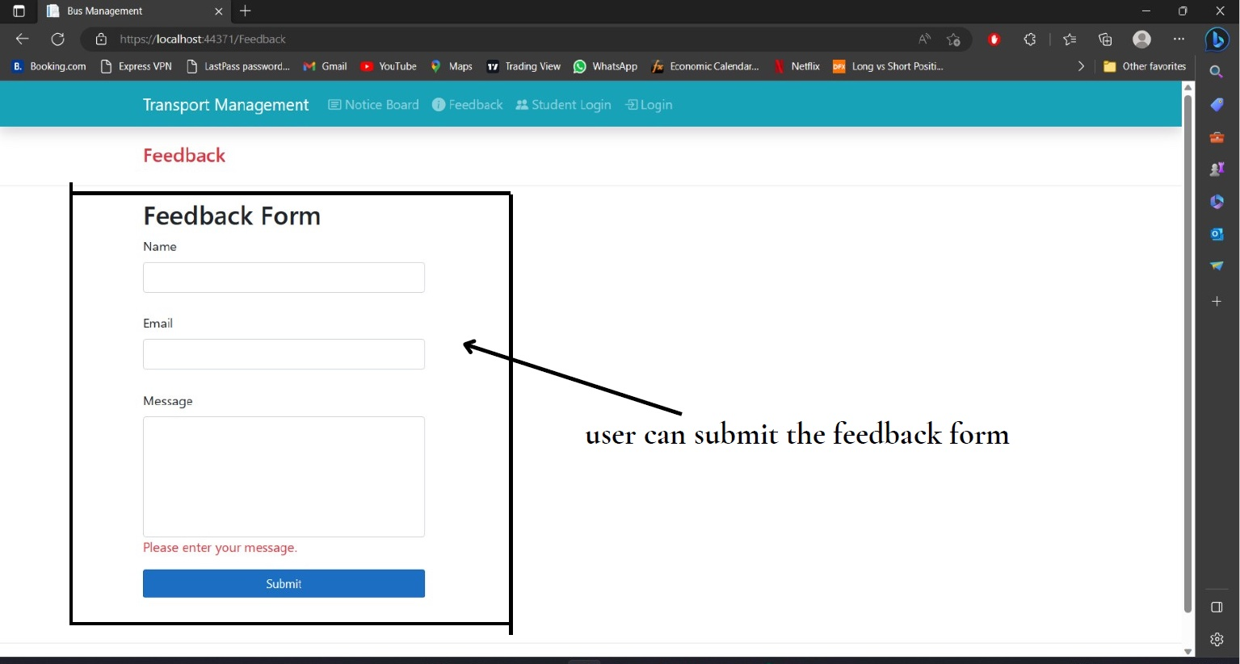
Feedback Form

Slide 20
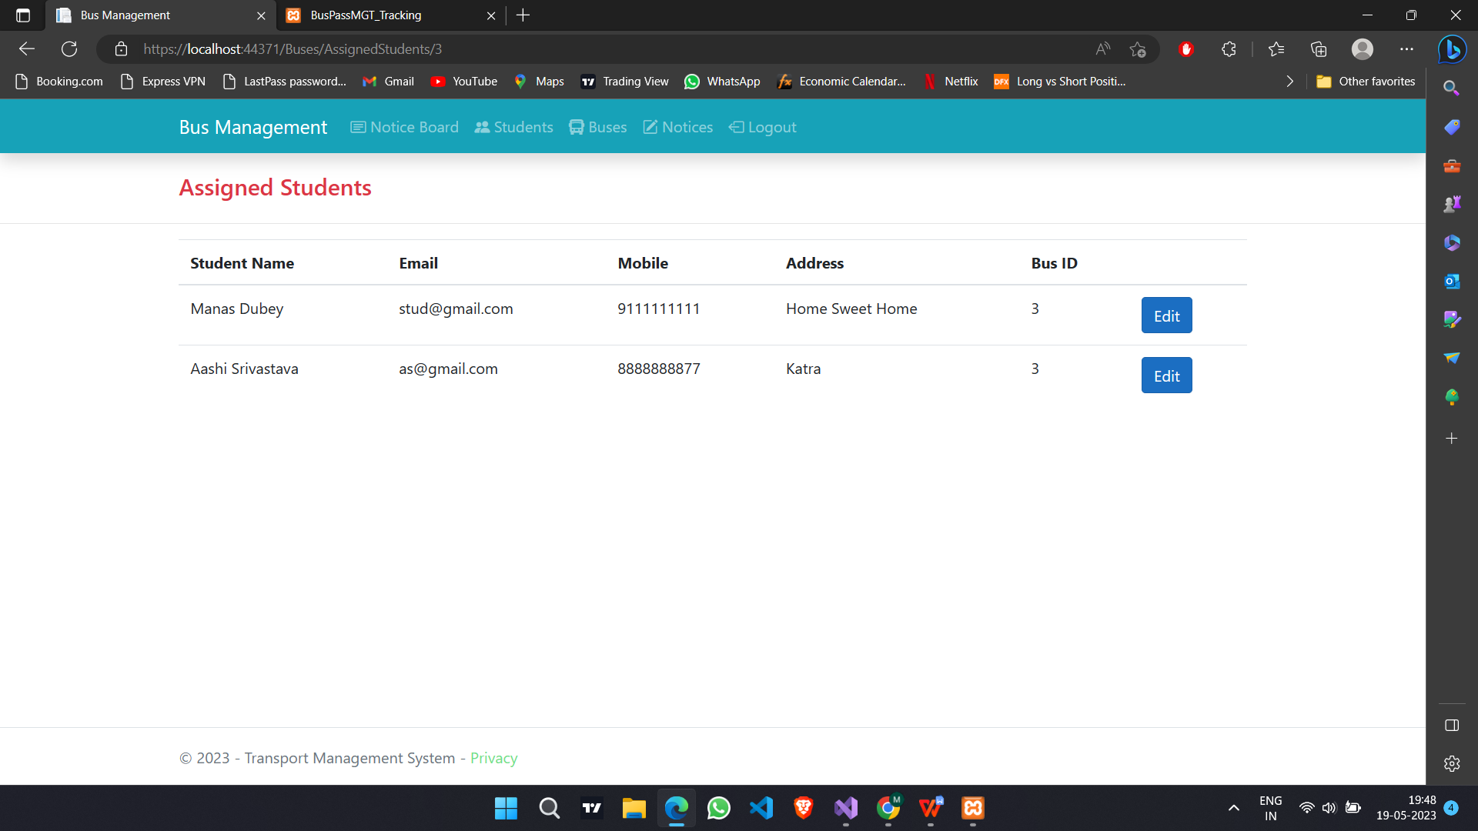
Assigned Students

Slide 21
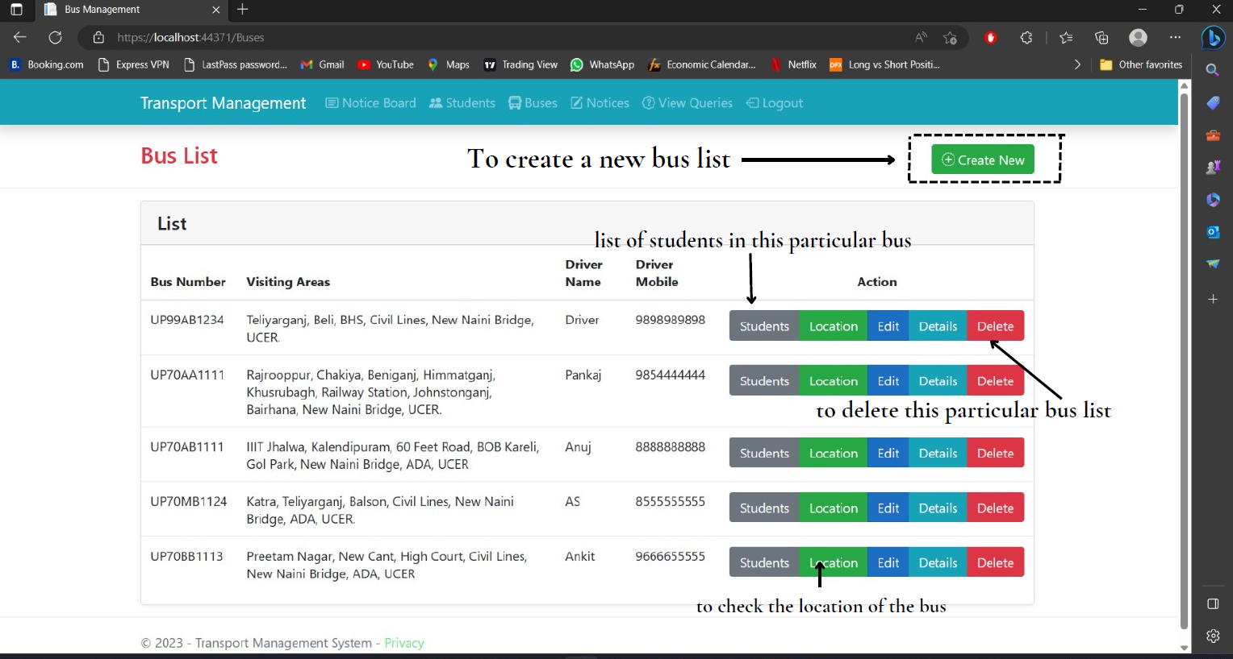
Bus Management

Slide 22
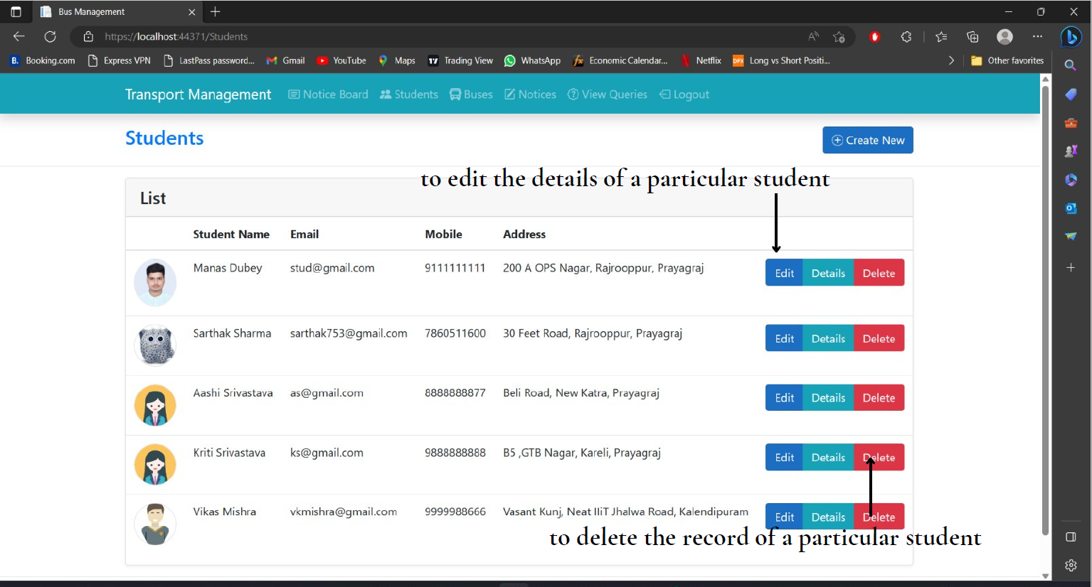
Student Management

Slide 23
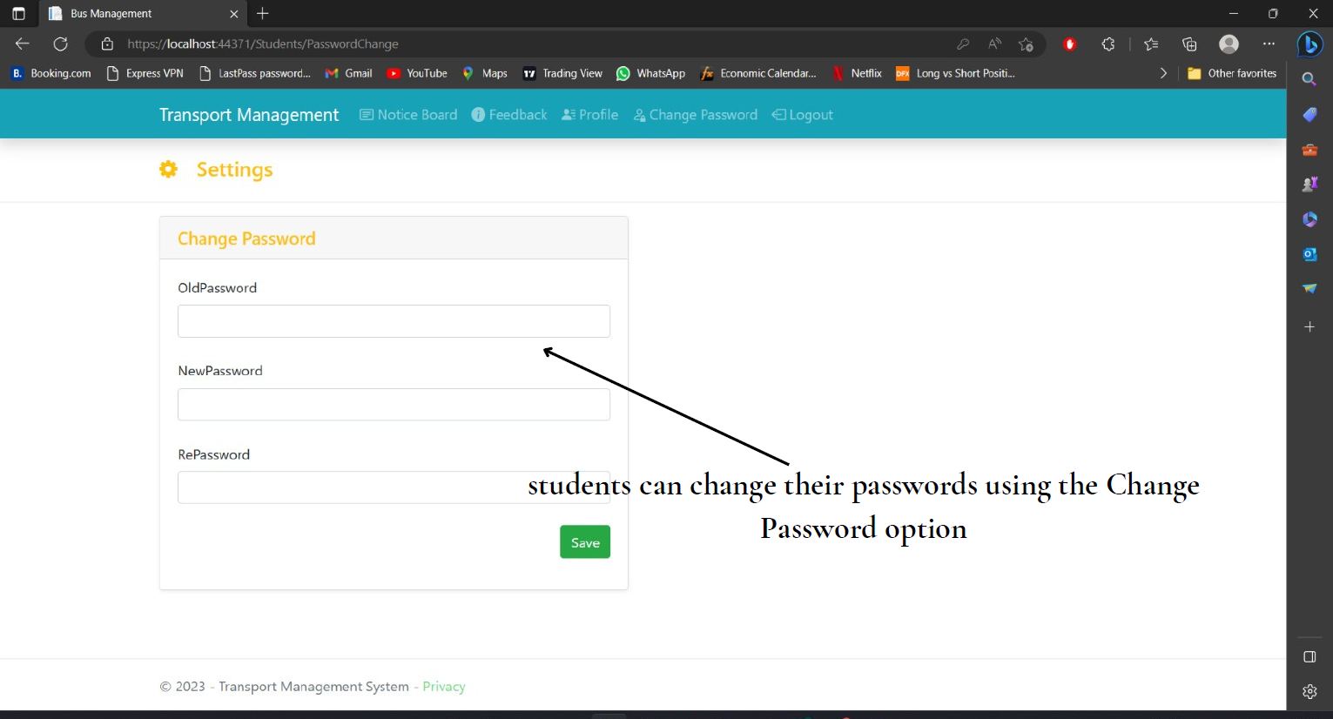
Password Update

Slide 24

System Security and Privacy
SSL Encryption: Ensures secure communication between server and client.
Client-Side Encryption: Encrypts user data before transmission.
Server-Side Encryption: Encrypts data stored in the database.
Access Control: Implements role-based access control for authorized user privileges.
Security Auditing: Regular assessments to identify and address vulnerabilities.
Privacy Protection: Adheres to privacy regulations for data collection and processing.
Data Encryption: Encrypts data in transit and at rest for confidentiality.
Regular Updates: Applies security patches and updates to mitigate known vulnerabilities.

Slide 25
Benefits and Outcomes
Enhanced efficiency through optimized bus routes and reduced costs.
Improved safety with real-time bus tracking and emergency response capabilities.
Convenient bus pass issuance process, reducing paperwork and administrative burden.
Effective communication facilitated through a centralized notice board for announcements and updates.
Potential cost savings through route optimization and resource management.
Enhanced user experience for students, drivers, and administrators.

Slide 26

Future Scope
Mobile Application Integration: Developing mobile apps for convenient access to the system on smartphones.
Advanced Analytics and Predictive Modeling: Utilizing data analytics and predictive modeling to optimize operations and make informed decisions.
Internet of Things (IoT) Integration: Incorporating IoT devices for real-time data collection and monitoring.
Enhanced Communication Channels: Implementing additional communication channels like push notifications and SMS alerts for improved user engagement.
Sustainability Initiatives: Promoting eco-friendly practices and exploring green transportation solutions.
Integration with Smart City Initiatives: Collaborating with smart city initiatives for integrated transportation management.
Predictive Maintenance: Implementing proactive maintenance strategies based on data analysis for efficient maintenance operations.
Enhanced Security Measures: Enhancing system security with advanced authentication methods and real-time monitoring.

Slide 27
Use cases of the transport management system in different fields
Corporate Transportation: The system can be utilized by companies to manage employee transportation, ensuring efficient routes, minimizing travel time, and enhancing employee safety and satisfaction.
Public Transportation: Transport authorities can leverage the system to optimize bus routes, provide real-time updates to passengers, and improve overall public transportation services.
School Transportation: Schools can utilize the system to manage bus routes, track bus locations, and enhance student safety during school transportation.
Event Management: The system can be employed for managing transportation logistics during large-scale events, coordinating shuttle services, and providing real-time updates to attendees.
Airport Transportation: Airports can utilize the system to manage shuttle services, track passenger arrivals, optimize routes, and ensure seamless transportation for travelers.
Medical Institutions: Hospitals and healthcare facilities can utilize the system to manage patient transportation, ensuring efficient routes for medical staff, and providing real-time updates to patients and their families.

Slide 28
Conclusion
Enhanced operational efficiency
Improved safety and security
Streamlined bus pass issuance process
Effective communication and information sharing
Data-driven decision-making and reporting
Improved user experience for students, drivers, and administrators
Potential cost savings through optimized routes and resource management

Slide 29
Thank you
Aashi Srivastava
Kriti Srivastava
Manas Dubey
Sarthak Sharma

